Slide 1

Customer Shopping Behavior Analysis
Analyzing 3,900 purchases to uncover spending patterns, customer segments, and strategic insights

Slide 2

DATASET OVERVIEW
The Foundation
3,900
18
50
Total Purchases
Data Columns
Locations
Transactions analyzed across all categories
Comprehensive customer and purchase attributes
Geographic diversity in customer base
25
Products
Unique items across four categories

Slide 3


PYTHON ANALYSIS
Data Preparation Process
01
Data Loading & Exploration
Imported dataset, checked structure with df.info() and summary statistics
02
Missing Data Handling
Imputed 37 missing Review Rating values using median by category
03
Feature Engineering
Created age_group and purchase_frequency_days columns
04
Database Integration
Connected to PostgreSQL for advanced SQL analysis

Slide 4
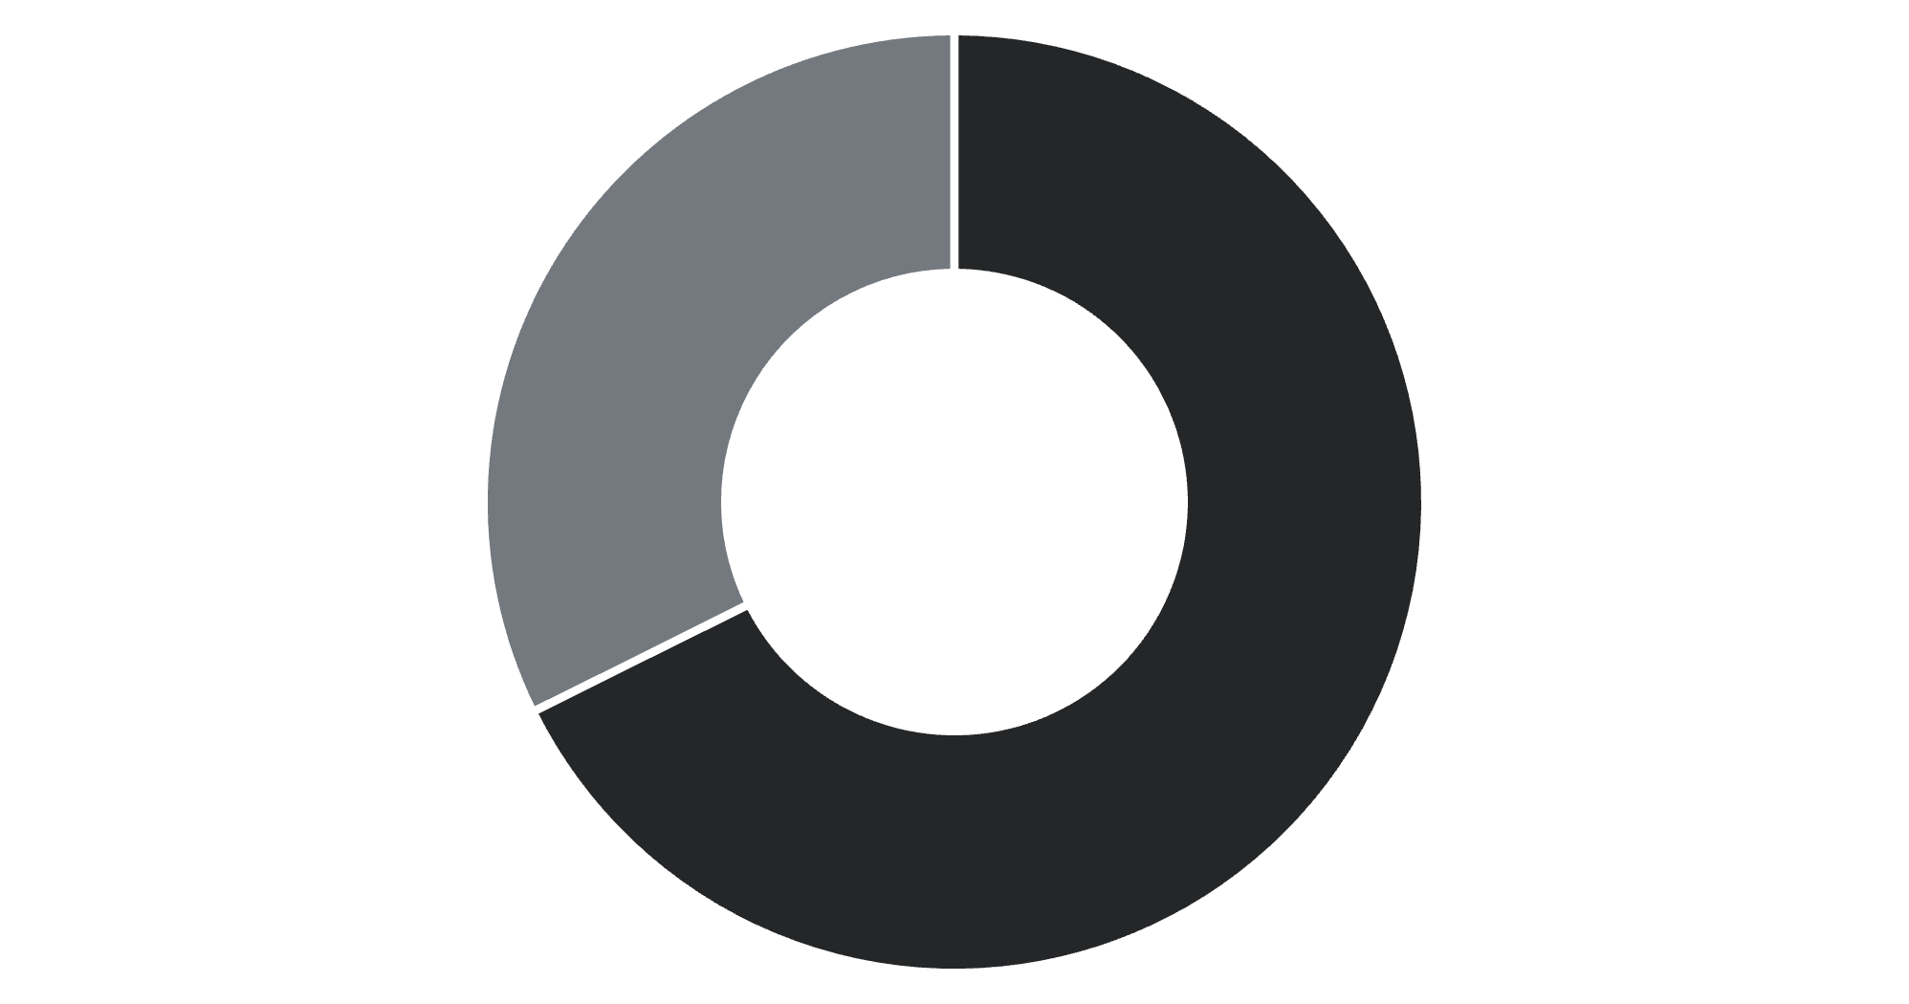
REVENUE INSIGHTS
Gender Revenue Analysis
Key Finding
Male customers generate 68% of total revenue, significantly outpacing female customers
Total revenue analyzed: $233,081
Male
Female

Slide 5


Customer Segmentation
Loyal Customers
Returning Buyers
New Customers
3,116 customers
701 customers
83 customers
Highest value segment with consistent purchase history
Growing segment showing repeat purchase behavior
Fresh acquisition opportunities for growth
Insight: 80% of customers fall into the Loyal segment, indicating strong retention but limited new customer acquisition

Slide 6
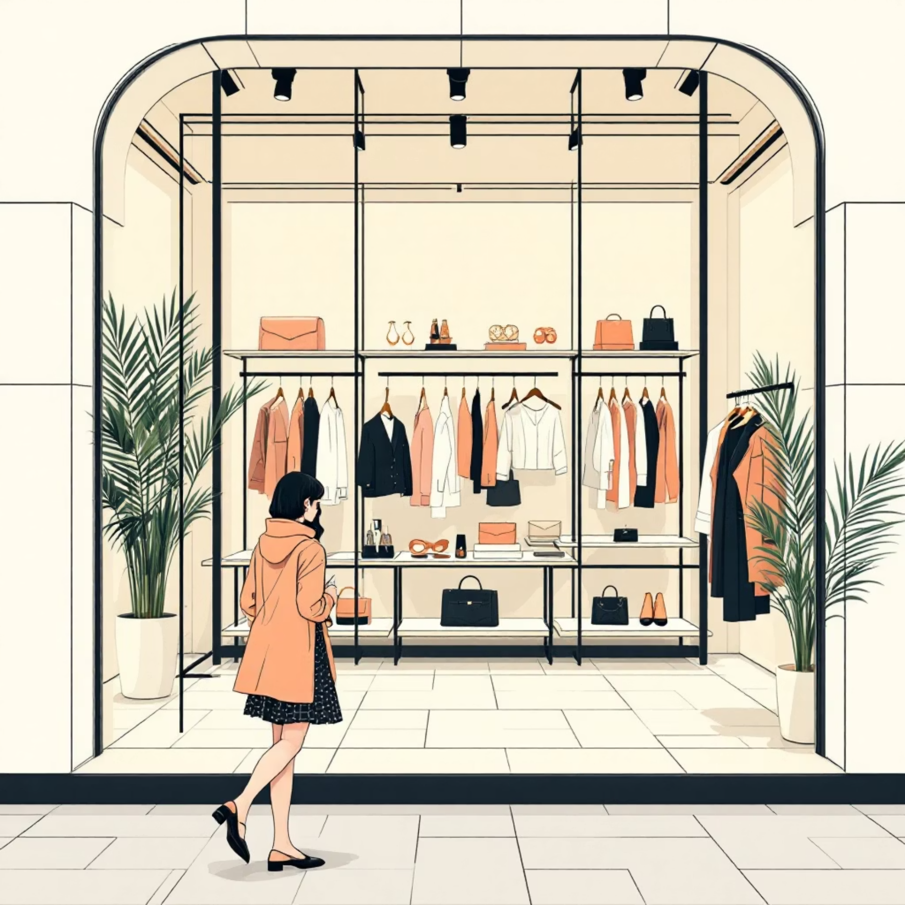
PRODUCT PERFORMANCE
Top-Rated Products
1
Category Leaders
Gloves
Accessories: Jewelry (171 orders)
Clothing: Blouse & Pants (171 orders each)
Rating: 3.86
Footwear: Sandals (160 orders)
Outerwear: Jacket (163 orders)
2
Sandals
Rating: 3.84
3
Boots
Rating: 3.82
4
Hat
Rating: 3.80
5
Skirt
Rating: 3.78

Slide 7



Subscription Impact Analysis
27%
Subscription Rate
1,053 of 3,900 customers subscribed
73%
Non-Subscribers
2,847 customers without subscription
Average spend nearly identical: $59.49 (subscribers) vs $59.87 (non-subscribers)
Repeat buyers (>5 purchases): 958 subscribed vs 2,518 non-subscribed

Slide 8
DISCOUNT STRATEGY
Discount Usage Patterns
50%
49.7%
49.1%
Hat
Sneakers
Coat
Highest discount rate
48.2%
47.4%
Sweater
Pants
Key Finding: 839 customers used discounts but still spent above average ($60), indicating price-conscious yet high-value shoppers

Slide 9
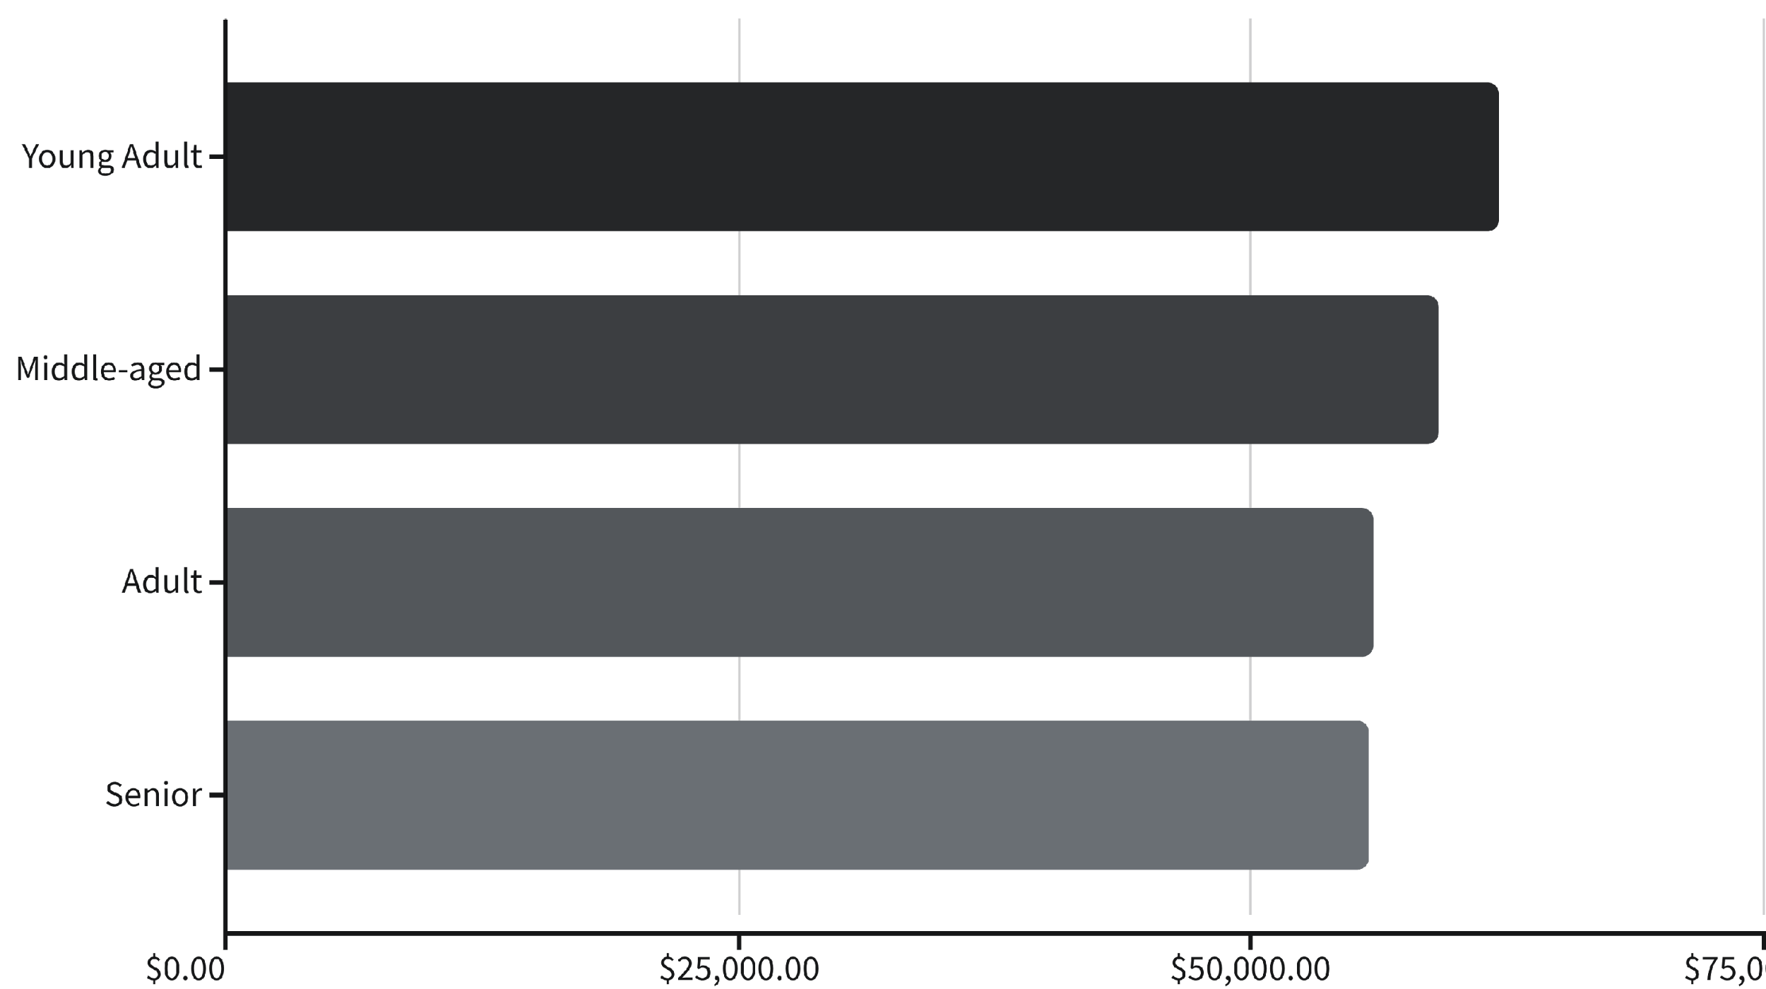
Age Group Revenue Distribution
Shipping Preference: Express shipping customers spend slightly more ($60.48) vs Standard ($58.46)
Distribution: Revenue relatively balanced across age groups, with Young Adults leading

Slide 10






ACTION PLAN
Strategic Recommendations
Boost Subscriptions
Loyalty Programs
Review Discount Policy
Promote exclusive benefits to convert the 73% non-subscriber base
Reward repeat buyers to strengthen the 80% loyal customer segment
Balance sales boosts with margin control on high-discount products
Product Positioning
Targeted Marketing
Highlight top-rated items (Gloves, Sandals, Boots) in marketing campaigns
Focus on Young Adults and express-shipping users for maximum ROI

